Slide 1
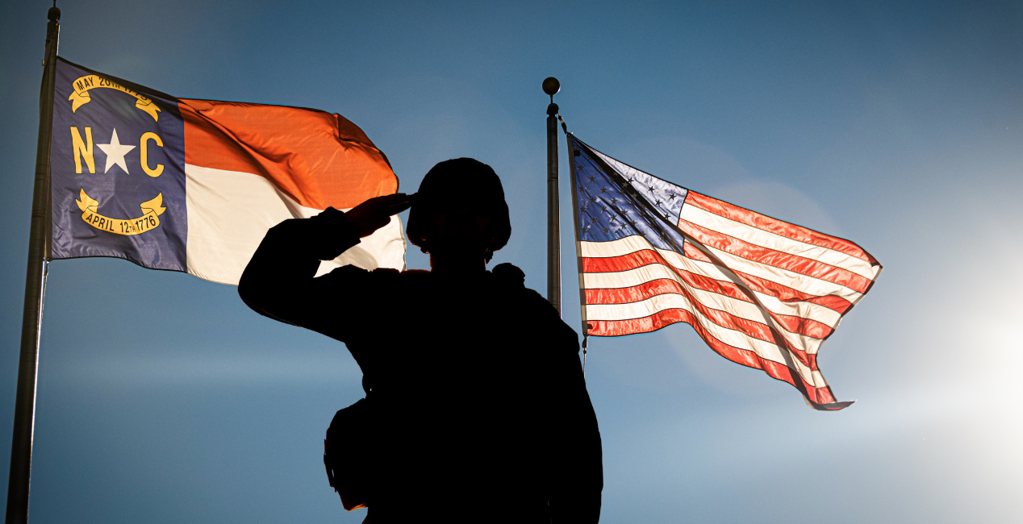
MOAA NCCOC 2025 State Priority Advocacy
LTC(R) Tricia A. Vinson
MOAA NCCOC VP State Legislative Advocate
Winter 2025
wing23pav@gmail.coml/757-617-3343

Slide 2
Who We Are
The North Carolina Council of Chapters (NCCOC) of MOAA provides programmatic guidance and oversight for the 14 state chapters that serve 1350 members in 100 counties. As one of 35 state councils that support the Military Officers Association of America (MOAA), we are serving the needs of military members in our state.
MOAA and its affiliated councils and chapters are independent, nonprofit and politically nonpartisan organization. Nationally, MOAA has over 360,000 members and is active in both federal & state legislation matters.
Among other missions, the NCCOC MOAA protects the interests of service retirees and active-duty military members in matters of North Carolina state legislation and connects with other state level MOAA councils through a quarterly state exchange forum.
Organize and coordinate the collective action of the Member Chapters in the State of North Carolina and is a voting member of the North Carolina Veteran’s Council
It serves the interests of retired, active, reserve, and National Guard personnel of the uniformed services and their dependents and survivors
MOAA is an association of officers and surviving spouses carrying out our role and responsibility to represent and support all ranks across all services at every stage of their careers. We are the leading voice to benefit all members of the uniformed services community.

Slide 3
Top Three Veteran Priorities for 2025
Updating Veteran Property Tax Exemptions:
Supporting Veteran In-State Housing/Care Programs:
a. Veteran State Homes Program Improvements:
b. WNC Veterans Restoration Quarters (VRQ) Rebuild:
3. Occupational Certification Portability & Economic Opportunities for Military/Veterans/Spouses (Subset of the Defense State Liaison Office (DSLO) Priorities)

Slide 4
1. Updating Veteran Property Tax Exemptions
1. Revisiting eligibility criteria for property tax relief based on disability ratings, home value caps, surviving spouse qualifications, and other considerations. This has consistently been a top concern for our chapter members. Veteran property tax exemptions (usually based on percentage of disability rating, but relook eligibility criteria, amount of home value/full or partial tax exemption, surviving spouse qualification, age criteria, etc.). This can also include the Disabled Veteran Motor Vehicle Tax Exemption if that bill is resubmitted, so this is not just limited to real estate, but that is the primary focus. Current law is not specific to veterans but does include veterans at a 100% disability rating and only for the first $45,000 of assessed real estate property value.

Slide 5
2. Supporting Veteran In-State Housing/Care Programs:
2a. Veteran State Homes Program Improvements: Addressing the five state-managed homes, including the unexpected closure of the Fayetteville home in 2023. Key areas include overarching management, funding decisions, Fayetteville home path forward, decisions for all 5 veteran homes and future homes within NC. This includes how the state trust fund money is authorized to be used (i.e. how can 10% be siphoned to the veteran’s cemetery fund when the money has been provided by Medicare/VA/and paid for by those currently residing in the state home structure?). Currently very disconnected.
2b. WNC Veterans Restoration Quarters (VRQ) Rebuild: Sec. Martin inspected with Gov. Cooper the destroyed VRQ and had it on his list for getting repaired/fixed. Hopefully Sec. Mallette, Esq. will support the efforts that Sec Martin had begun during his short tenure. Supporting the rebuilding efforts for the VRQ in Asheville, which was destroyed during Helene, displacing approximately 200 male homeless veterans. We hope this will be on the Department of Military Veteran Affairs’ (DMVA) priorities list that will support veterans across the state. The mission of Veterans Restoration Quarters is to create a principle-based environment and comprehensive residential program that addresses every area of restoration in the life of a homeless veteran.

Slide 6
3. Occupational Certification Portability & Economic Opportunities for Military/Veterans/Spouses (Subset of the Defense State Liaison Office (DSLO) Priorities)
3. Enhancing state level occupational licensing portability and supporting interstate compacts, which benefit active-duty personnel, veterans and their family's seeking employment in North Carolina. This is one of DSLO's top 10 priority efforts. Supporting initiatives like aligning state laws with federal policies (Title 10 & 38 CFR), Space Force recognition, make NC compatible with other states/ federal policies for eligibility of benefits. Also includes remote driver license and vehicle license renewal; military family needs, military family childcare, military interpersonal violence and family antidiscrimination status.

Slide 7
Conclusion
We have made these priorities very broad on purpose. Recognizing each category has multiple subcategories we provide a start point for a dialog to be initiated.

Slide 8
Backup Slides

Slide 9
Where Do NC MOAA State Issues Come From?
The chapter presidents and their legislative leads are provided information from previous year as a start point to work with their chapters to see if a revision is needed. They may add, delete, modify, and provide their top three issues back to the council.
Primarily, State Issues Come From Three Places:
MOAA Chapter Members & NCCOC (board-approved consolidated list compiled and prioritized)
NC Veteran Council List of State Issues (Collected from all Veteran Service Organization (VSO) voting member organizations and prioritized by the council)
Defense State Liaison Office https://statepolicy.militaryonesource.mil

